Slide 1
Pretrained Models -
BERT, GPT, T5
Natural Language Processing
(based on revision of John Hewitt and Colin Raffel Lectures)

Slide 2
Announcement
TA announcements (if any)...

Slide 3
Suggested Readings
BERT: Pre-training of Deep Bidirectional Transformers for Language Understanding (original paper of BERT)
T5 Model (original paper of the T5 model; lots of stuffs about multi-task learning and transfer learning)

Slide 4
Pretraining

Slide 5
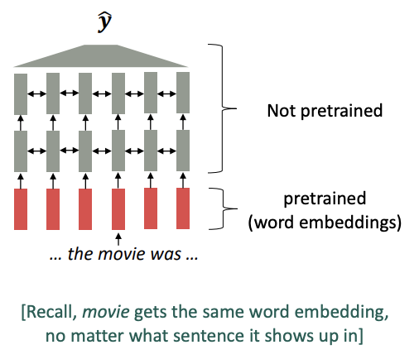
Before: Pre-trained word embeddings
Before 2017
Start with pre-trained word embeddings
Some issues
The training data for our downstream task (like question answering) must be sufficient to teach all contextual aspects of language
Most of the parameters in our network are randomly initialized

Slide 6
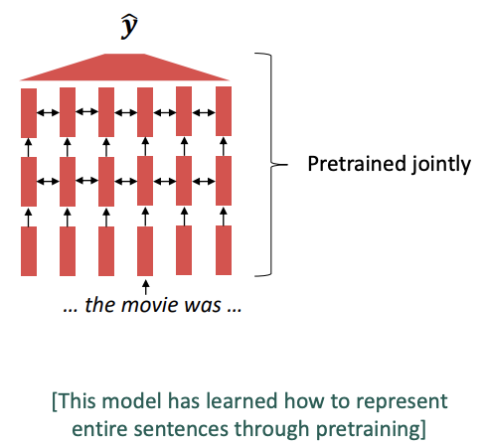
Now: Pre-trained whole models
All (or almost all) parameters in NLP networks are initialized via pretraining
Pretraining is the process of developing a pretrained model that is able to generalized to different other tasks
If we were to generalize the model to many other tasks, the pretraining problem should be “representative”. (covered more later)
New baseline, because pretrained models can capture very strong
Embeddings: Representations of language
General NLP tasks: Parameter initializations
Generate text: Probability distributions
One big drawback is that pre-training takes many days and many TPUs... (but fine tuning is very quick and can work on only one GPU)

Slide 7
Pre-training objectives
To create pretrained models, we got to be smart on thinking about the problems that the model solve, such that it can be generalized to other tasks
Answer: One good way is LM!! Many aspects can be learned in this way:
Stanford University is located in __________, California. [location]
I put ___ fork down on the table. [syntax]
The woman walked across the street, checking for traffic over ___ shoulder. [coreference]
I went to the ocean to see the fish, turtles, seals, and _____. [lexical semantics/topic]
Overall, the value I got from the two hours watching it was the sum total of the popcorn and the drink. The movie was ___. [sentiment]
Iroh went into the kitchen to make some tea. Standing next to Iroh, Zuko pondered his destiny. Zuko left the ______. [some spatial reasoning]
I was thinking about the sequence that goes 1, 1, 2, 3, 5, 8, 13, 21, ____ [some basic arithmetic]
1 + 1 = ____ [ basic addition]

Slide 8
Pre-training approaches
Pre-training can be categorized into three categories:
Decoder
Pretrained using LM
Useful for generating text or classification
E.g., GPT
Encoder
Pretrained using Masked LM
Gets bidirectional context
Useful for classification
Cannot generate text
E.g., BERT
Encoder-Decoder
Pretrained using a unified structure
Useful for generating text
E.g., T5, Bart, Pegasus

Slide 9
Pretraining - decoders

Slide 10
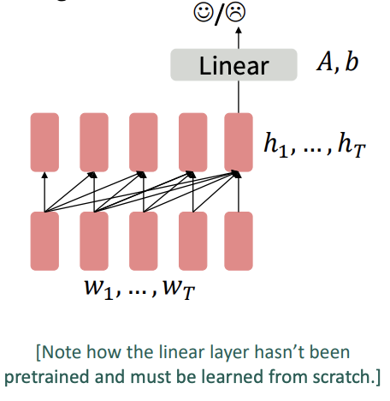
Pretraining - decoders as classifier
During pre-training, treat it as a LM
Train on a huge huge corpus and on many days…
Then we can finetune them by training a classifier (here Linear, with A as the W matrix and b as the bias) on the last word’s hidden state (assumed to capture the whole sequence states)
Note that the linear layer hasn’t been pretrained and must be learned from scratch

Slide 11
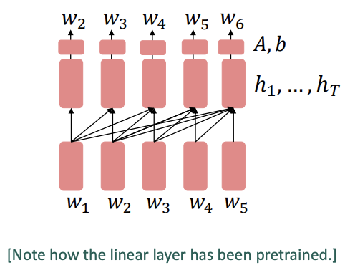
Pretraining - decoders as generator
During pre-training, treat it as a LM
Train on a huge huge corpus and on many days…
During finetuning: provides the specific domain datasets (summarization, dialogue) and let the gradients backpropagate again
Note that the linear layers has already been pretrained (i.e., A and b). This is different from decoder as classifier situtaton.

Slide 12
Pretraining - decoders - GPT [Radford et al. 2018]
2018’s GPT was a big success in pretraining a decoder!
Transformer decoder with 12 layers
768-dimensional hidden states, 3072-dimensional feed-forward hidden layers.
Byte-pair encoding with 40,000 merges
Trained on BooksCorpus: over 7000 unique books.
Contains long spans of contiguous text, for learning long-distance dependencies
The acronym “GPT” never showed up in the original paper; it could stand for “Generative PreTraining” or “Generative Pretrained Transformer”
Improving Language Understanding by Generative Pre-Training, Radford et al. 2018, https://www.cs.ubc.ca/~amuham01/LING530/papers/radford2018improving.pdf

Slide 13
Pretraining - decoders - GPT
How do we format inputs to our decoder for finetuning tasks?
Natural Language Inference: label pairs of sentences as entailing/contradictory/neutral. E.g., entailing pair
Premise: The man is in the doorway
Hypothesis: The person is near the door
To not change the architecture, Radford et al. 2018 simply format the input like this, where a linear classifier is applied to the embedding vector of the [EXTRACT] token.
[START] The man is in the doorway [DELIM] The person is near the door [EXTRACT]

Slide 14
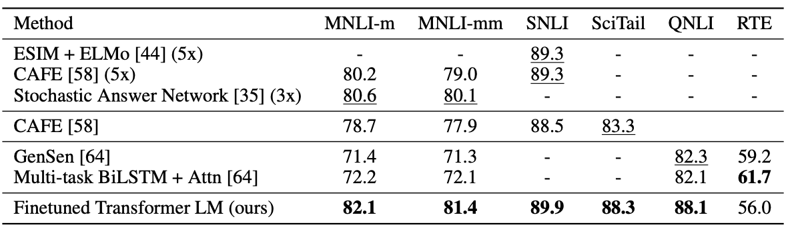
Pretraining - decoders - GPT
Results of GPT on natural language inference datasets

Slide 15
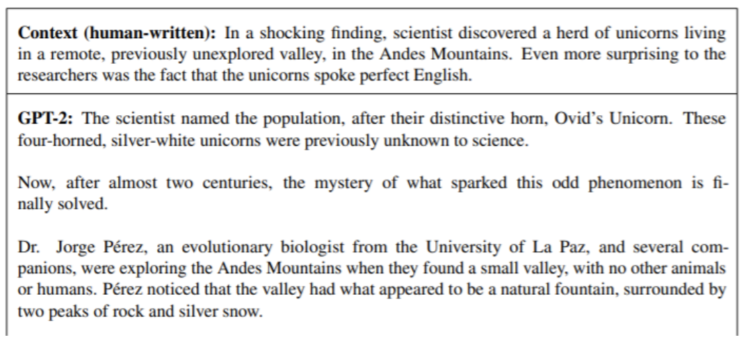
Pretraining - decoders - GPT2
GPT2 - trained on more data, was shown to produce relatively good grammatical samples

Slide 16
Pretraining - encoders

Slide 17
Pretraining - encoders - how to train?
Ok, decoders look great….so why bother encoder approaches?
In decoder approaches, it assumes masked attention is used, thus bidirectionality context cannot be utilized. If we want bidirectionality, we got to remove the masked attention unit, which turns to be basically the encoder!
So can we pretrain our model using the encoder approaches?
But wait, then we cannot train using the same pretraining objective as decoder, because the future is not masked
So what pretraining objective to use?

Slide 18
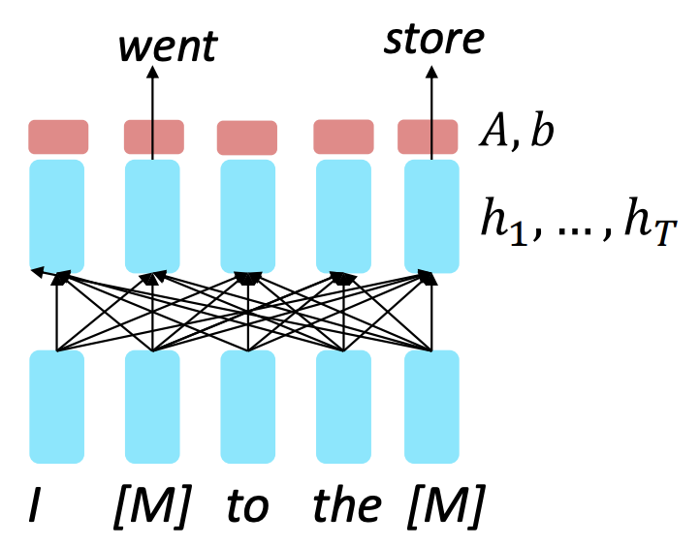
Pretraining - encoders - how to train?
Idea: Use Masked LM
Replace some fraction of words in the input with special [MASK] token; predict these words
Only add loss terms from words that are “masked” out.
Basic idea behind BERT

Slide 19
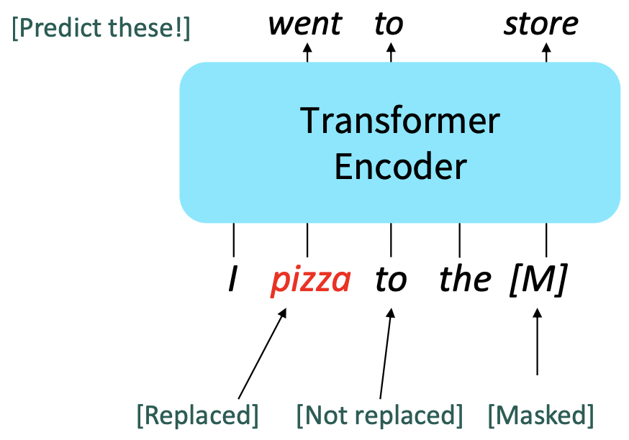
Pretraining - encoders - BERT [Devlin et al., NAACL 2018]
Devlin et al. 2018 proposed the “Masked LM” objective and released the weights of a pretrained Transformer called BERT (Bidirectional Encoder Representations from Transformers)
Predict a random 15% of (sub)word tokens
Replace input word with [MASK] 80% of the time
Replace input word with a random token 10% of the time
Leave input word unchanged 10% of the time (but still predict it)
Why? Doesn’t let the model get complacent and not build strong representations of non-masked words (No masks are seen at fine-tuning time!)
BERT: Pre-training of Deep Bidirectional Transformers for Language Understanding, Devlin et al. 2018, https://arxiv.org/pdf/1810.04805.pdf

Slide 20
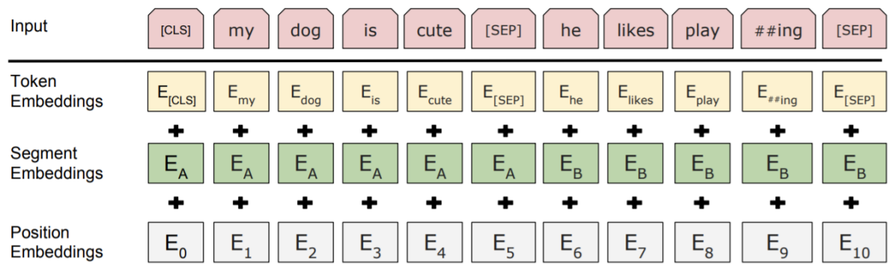
Pretraining - encoders - BERT
More details
The whole sequence length is 512
The pretraining input to BERT will be always be a two separate contiguous chunks of text (together 512)
In addition of the masked LM, simultaneously, BERT was trained to predict whether one chunk follows the other or is randomly sampled
Later work has argued this “next sentence prediction” is not necessary….huh?!

Slide 21
Pretraining - encoders - BERT
More details :-)
Two models were released
BERT-base: 12 layers, 768-dim hidden states, 12 attention heads, 110 million params.
BERT-large: 24 layers, 1024-dim hidden states, 16 attention heads, 340 million params.
Trained on:
BooksCorpus (800 million words)
English Wikipedia (2,500 million words)
Pretraining is expensive and impractical on a single GPU
BERT was pretrained with 64 TPU chips for a total of 4 days.
Finetuning is practical and common on a single GPU. Yay!
Pretrain once, finetune many times.

Slide 22
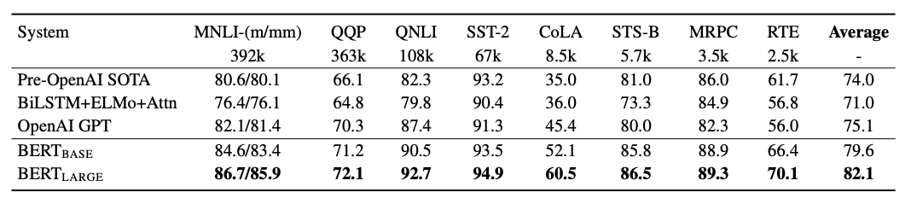
Pretraining - encoders - BERT
BERT was massively popular and versatile; finetuning BERT led to new state-of-the-art results on a broad range of tasks
QQP : Quora Question Pairs (detect paraphrase questions)
QNLI : Natural Language Inference Over Question-Answering Data
SST-2 : sentiment analysis
CoLA : corpus of linguistic acceptability (detect whether sentences are grammatical)
STS-B : semantic textual similarity
MRPC : microsoft paraphrase corpus
RTE: a small natural language inference corpus

Slide 23
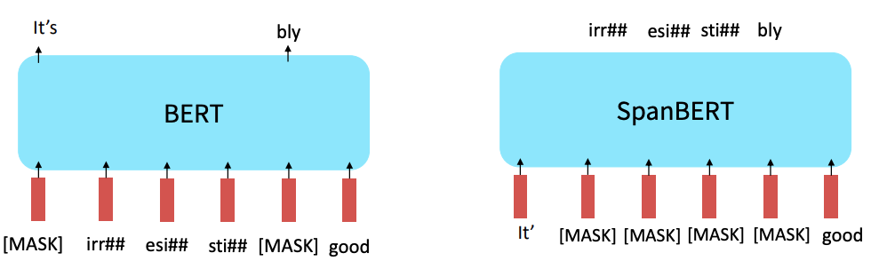
Extensions of BERT
Many more BERT variants like RoBERTa, SpanBERT, and others!
RoBERTa: mainly just train BERT for longer and remove next sentence prediction
SpanBERT: masking contiguous spans of words makes a harder, more useful pretraining task
RoBERTa: A Robustly Optimized BERT Pretraining Approach, Liu et al. 2019, https://arxiv.org/abs/1907.11692
SpanBERT: Improving Pre-training by Representing and Predicting Spans, Joshi et al. 2019, https://arxiv.org/abs/1907.10529

Slide 24
Pretraining - encoder-decoder

Slide 25
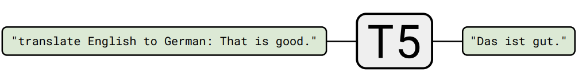
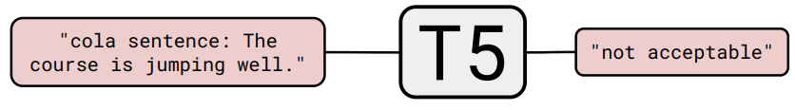
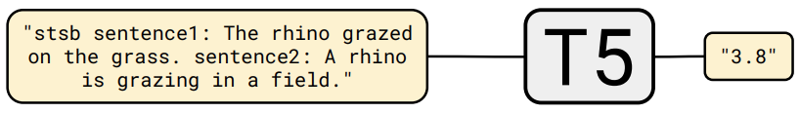
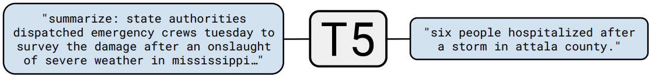
Pretraining - encoder-decoder - T5 [Raffel et al., J.Mach.Learn 2020]
One of the first paper to propose pretrained encoder-decoder architecture is of Raffel et al. 2018 T5 model. Proposed as a unified text-to-text model, treating all problems as text-to-text with prefix specifying the problem type
Exploring the Limits of Transfer Learning with a Unified Text-to-Text Transformer, Raffel et al., 2020, https://arxiv.org/pdf/1910.10683.pdf

Slide 26
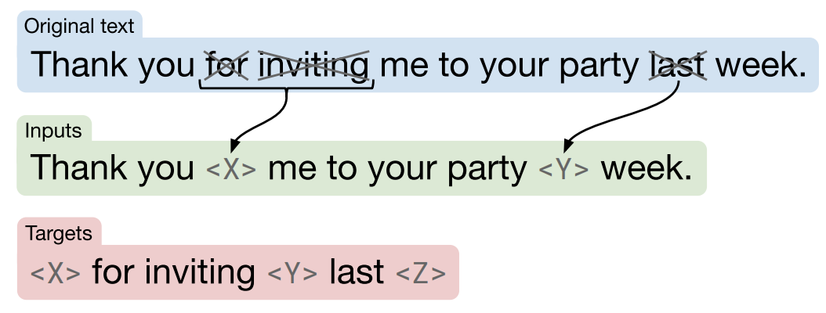
Pretraining - encoder-decoder - T5
Training objective
Very similar to BERT
But instead, reconstruct only the masked tokens
Authors claim that this design decision is made to reduce computational cost
They could achieve the same performance as BERT with only ¼ of computational cost
<- Inputs to the encoder
<- Targets of the decoder

Slide 27
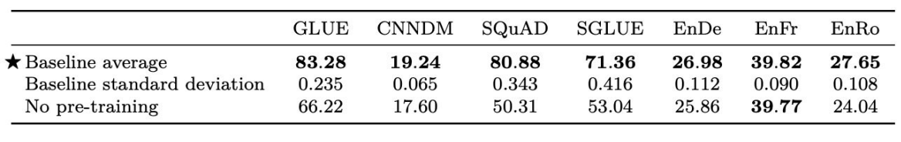
Pretraining - encoder-decoder - T5
Use the pretrained model that has been trained on some C4 data (custom crawling dataset), and then after pretraining, finetune on different tasks

Slide 28
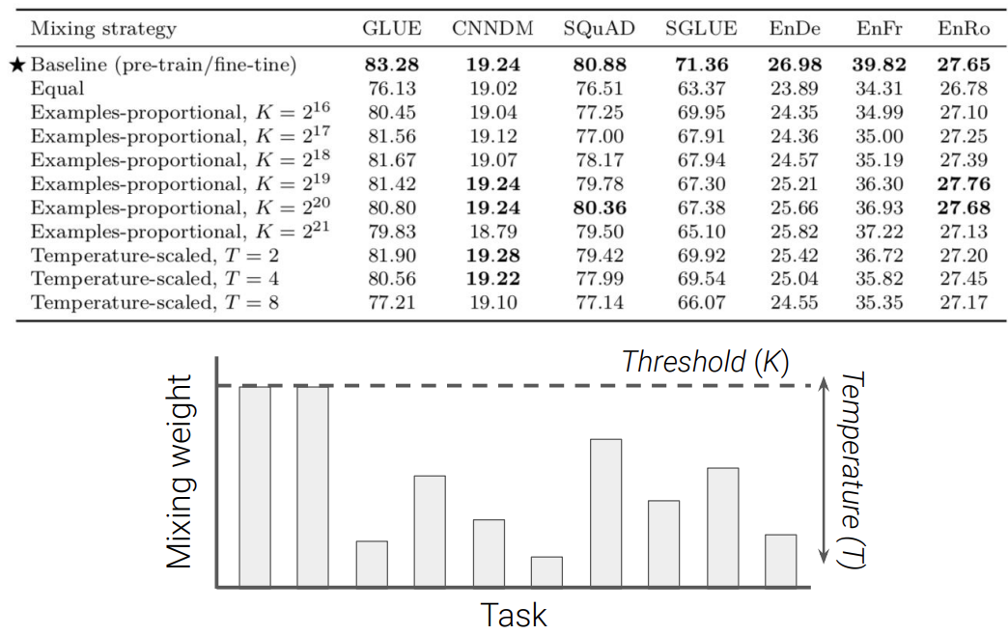
Pretraining - encoder-decoder - T5
Multi-task learning - pretraining and finetuning all the tasks everything together...the pretraining C4 tasks, the GLUE tasks, the CNNDM tasks, etc.
Because the pretraining tasks are much much bigger than any other tasks, it will take forever before the downstreaming tasks gots a chance to be trained
Solution: Introduce a hyperparameter K to decide when to stop training on the pretraining dataset
Then we can set a temperature T to choose how many samples we want from each dataset

Slide 29
Pretraining - encoder-decoder - T5
Also tried on question-answering task on another separate paper
Before that, let me introduce briefly type of question-answering task. It can be categorized into broadly three types:
Reading comprehension
Open-domain question answering
Closed-book question answering

Slide 30
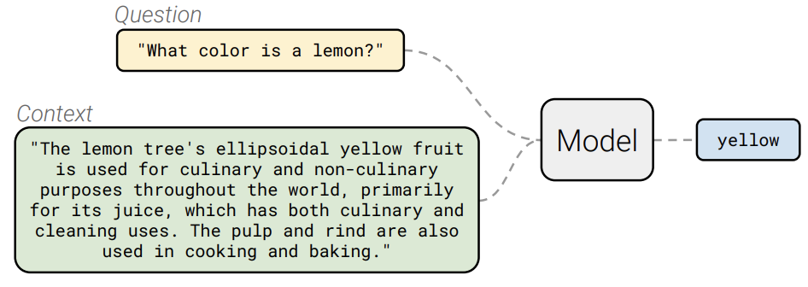
Pretraining - encoder-decoder - T5
Reading comprehension

Slide 31
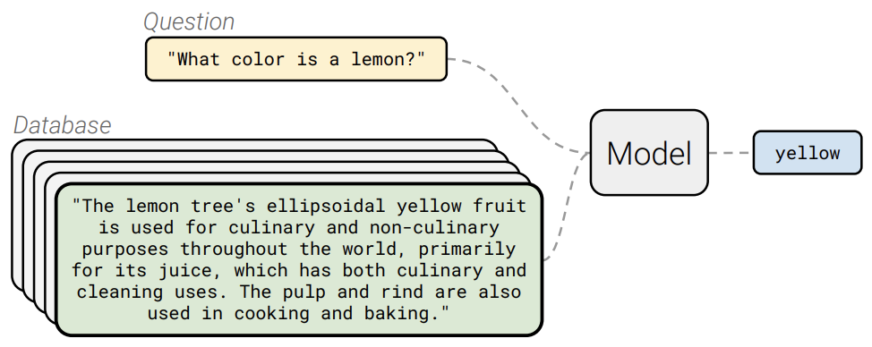
Pretraining - encoder-decoder - T5
Open-domain question answering

Slide 32
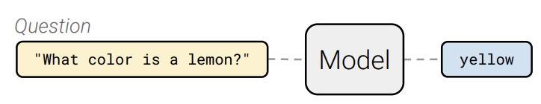
Pretraining - encoder-decoder - T5
Closed-book question answering

Slide 33
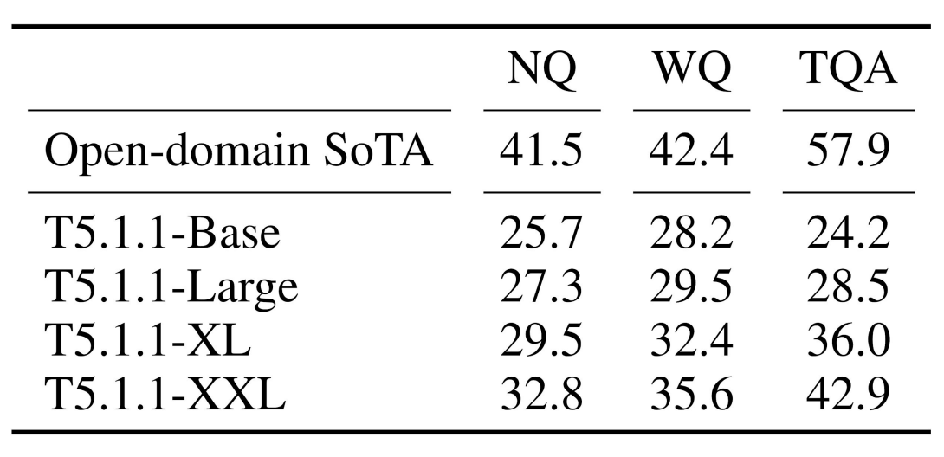
Pretraining - encoder-decoder - T5
They took some question answering tasks (natural question, web question, trivia question answering datasets) and took out all the context. Metric is the ratio of the number of shared words to the total number of words in the ground truth.

Slide 34
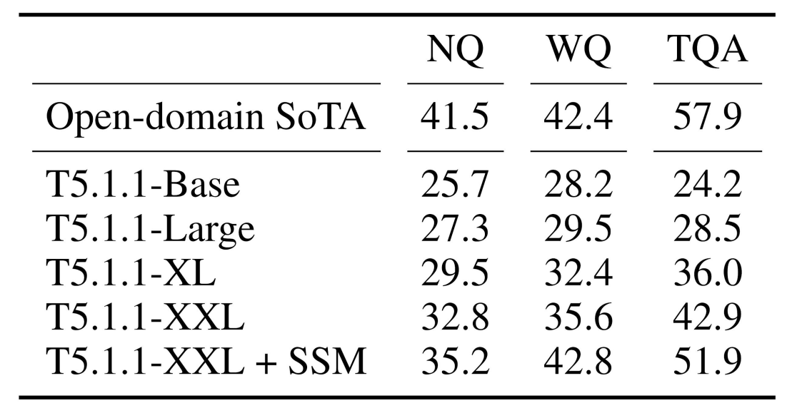
Pretraining - encoder-decoder - T5
They revised their training objectives, masking ONLY the entities (Salient Span Masking).

Slide 35
Very large models and
in-context learning

Slide 36
GPT-3, in-context learning (few shots learning)
Some very large models seem to perform some kind of learning without gradient steps simply from examples you provide within their contexts! Also known as in-context learning (very similar to few shot learning).
GPT-3 is the canonical example of this. The largest T5 model had 11 billion parameters. GPT-3 has 175 billion parameters

Slide 37
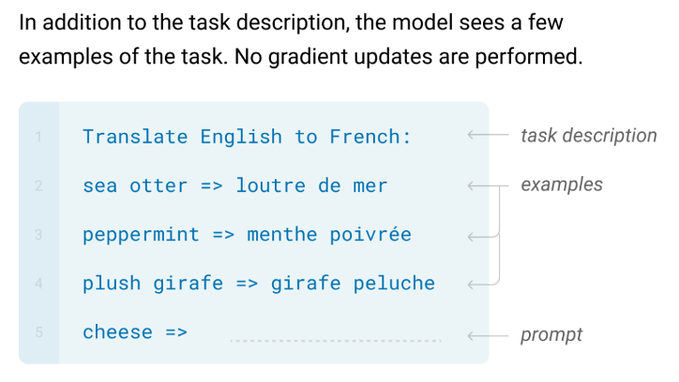
GPT-3, in-context learning (few shots learning)

Slide 38
Finetuning

Slide 39
Common practices
Art rather than science
Fine-tune with small learning rates
Not to overly override the pretrained models
Smaller learning rates for earlier layers
Freeze earlier layers, then gradually unfreeze
Slowly decaying the learning rates
Reinitialize or add last layer
When in doubt, search optimal hyper parameters using cross-val
Pick the pretrained models that are trained on tasks with similar structure or underlying knowledge required as your task

Slide 40
Multi-task learning vs. Transfer learning vs. Meta learning

Slide 41
Same final dream, but different approaches
Multi-task learning
Simultaneously train on many tasks; assume you have all tasks data at once
Often requires you to structure your tasks to share same structure
Not easy because some tasks are learned more quickly/slowly, thus require handpicked training process (e.g., trained on harder tasks twice as easier tasks on a batch)
Very successful method is mixture of experts
Transfer learning
Train on one task/subject, and transfer your knowledge to another related task or subject
Very successful method is fine-tuning, but requires very large source dataset and moderate size target dataset
A possible problem is input discrepancy (e.g., shape) or structure (e.g., different data structures)
Meta learning (also called few-shot learning)
Comes in when you have very small target dataset (cannot transfer learning)
Keep on training on different tasks sequentially (with same k and n)
K-shot learning refers to learning using only k training examples for that class (e.g., one-shot learning, or five shots learning)
N-way classification refers to the classification based on choosing among n classes
Don’t know why, but they called training set the “support set” and test set as the “query set”
Then on the testing set, you hope that based on only k training data mixed in n classes, you can “learn” to do the modeling
One very successful method is MAML and its variants.

Slide 42
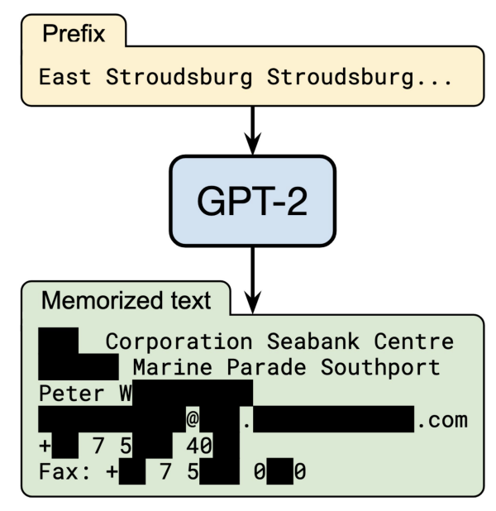
Summary
Almost always use pre-trained + fine-tuning models as one of the baselines
Training objective SEEMS to be the key factor
These models are still not well-understood
Multi-task learning, transfer learning, meta learning is the future of AI.
Remaining problems
Training cost - never enough….
Training objectives
Multi-task
Reasoning, knowledge, common sense
Output confidential information?
Many things to analyze and understand

